Slide 1
System Development Life Cycle: A Brief Introduction
Systems I – 420-E11

Slide 2
Pop Quiz
Let’s answer some review questions together
GOOD TIME TO TAKE NOTES!!!!
Notes:
Project manager: Overviews the whole project and runs it. He’s the manager of the whole thing.
- Managers resources (cost, people, time, etc.)
- Assign resources to members of the team
Primary point of contact for people on the team
Takes care of the planning on the project
4 phases of system development:
Plan
- Business value
- Feasibility
- Work plan/project plan
- Resource assigning
Analyze
- What your clients need
- Information gathering
- Process models
- Workflows
Design- How?
- Database design
- Prototypes
- Interface design
implementation
- Construction
- Installation
- Configure
- Lessons learned/feedback (post implementation)
post implementation
- Improvements and bug fixes
- Hardware maintenance
- Software maintenance
- Ongoing maintenance
Project roles:
Project manager
Developers
Testers
Analysts
Product support
Stakeholders
- May or may not be a user of the system
- Can be developers, analysts, programmers, anyone
- Customers (end users, system owner)

Slide 3

Food for thought
Can an IT Support Staff member be considered a project team member?
Notes:
Which role might they play? Infrastructure analyst
Example, the rollout of VDI at heritage is a project. It had a start date and end date, and it had a detailed plan.
Who would the project manager be in this case? Any ideas?
An other example….
We talked about Operations phase of projects, which happens after they go into production. IT support is part of this maintenance. So they play the role of maintaining the operation of the system.
Example. The roll out of a new version of a COTS product. In the initial rollout, the IT support has to update all existing users. But when a new user comes along, they have to add it to the new users. This is part of ‘Operations’ or the maintenance of operations.

Slide 4
What will we learn today?
4 phases of SDLCs
Deliverables
Project Management
SDLC Methodologies
Structured – eg. Waterfall, Parallel
Rapid Application Development – eg. Prototyping
Agile (scrums/sprints)

Slide 5
Large or Complex System
Examples?
Notes:
Implementing VDI – at heritage (small/medium) < 1000
At a gov’t dept (large) > 5000 people
And issues/ expiriences that they wish to share about unexpected issues encountered?
Another example: Phoenix
http://www.fmi.ca/media/381149/Claire%20Caloren%20EN.pdf - slides on Pay Modernization Project
http://www.cbc.ca/news/politics/phoenix-pay-fix-cost-1.3733154 - website w/ current status of project

Slide 6
Current Large IT Failures
New Public Service Payroll System – Phoenix
720 public servants — mostly new hires and students — have not received pay
1,100 have not received parental, long-term disability or severance payments
> 80,000 employees entitled to supplementary pay for extra duties, over-time or pay adjustments have had problems.
Notes:
http://www.cbc.ca/news/politics/phoenix-payroll-problems-fix-1.3683735
Public servants have reported maxed-out credit cards, depleted savings and unpaid bills

Slide 7
Recent Significant IT Failures
Company | Year | Outcome
Hudson Bay | 2005 | Inventory system problems lead to $33.3 million loss.
UK Inland Revenue | 2004/5 | $3.45 billion tax-credit overpayment caused by software errors.
Avis Europe PLC (UK) | 2004 | Enterprise resource planning (ERP) system cancelled after $54.5 million spent.
Ford Motor Co. | 2004 | Purchasing system abandoned after deployment costing approximately $400 M
Hewlett-Packard Co. | 2004 | ERP system problems contribute to $160 million loss.
AT&T Wireless | 2004 | Customer relations management system upgrade problems lead to $100M loss
Notes:
Source: Charette, Robert N., “Why Software Fails,” IEEE Spectrum Online, Sept. 2005.

Slide 8
Why do Software Projects Fail?
60% – 80% of project failures can be attributed directly to:
poor requirements gathering
Insufficient analysis
poor management (Meta Group)
Notes:
The clients don’t have a detailed knowledge of what they require
The clients are not able to properly communicate their needs
The analysts do not properly interpret the requirements

Slide 9
Main Challenges for Software Projects
13% of all projects lack user input
12% of all projects have incomplete requirements
12% of all projects can’t deal with changing requirements
Notes:
Reference: Standish Groups Chaos report survey, 1994

Slide 10
Systems Development Life Cycle
Planning
Analysis
Design
Implementation

Slide 11
SDLC: Planning- Why
Project Initiation
Develop a system request
Conduct a feasibility analysis
Project Management
Develop work plan
Staff the project
Control and direct the project
Why should we build this system?
Notes:
WHY?

Slide 12
SDLC: Analysis- What
Develop analysis strategy
Gather requirements
Develop a system proposal
What should the system do for us?
Where and when will it be used?
Notes:
WHAT?

Slide 13
SDLC: Design- How
Develop a design strategy
Design architecture and interfaces
Develop databases and file specifications
Develop the program design
How will we build the system?
Notes:
HOW?

Slide 14
SDLC: Implementation- Do
Construct system
Install system
Implement a training plan for the users
Establish a support plan
Build the system!
Notes:
BUILD

Slide 15
Characteristics of SDLCs
Each phase/steps leads to specific deliverables
The system evolves through gradual refinement
Phases are interative
Notes:
Once the system is implemented, it may go back into a planning phase for its next revision, a follow-on system, or maintenance releases

Slide 16
What is a deliverable?
Proof that you have completed the current phase and you can proceed to the next.
Notes:
Write 4 phases and ask for examples
Planning
Business Case
Project Plan
Analysis
Business Requirements
System Use Cases
Design
database model
UI design
process models
prototypes
Implementation
help desk script
implementation installation guide
maintenance/support instructions
training/user guide
Business Requirements
System Use cases
Technical Architecture Document
Test Cases
Test results

Slide 17
Processes and Deliverables
Process
Product
Project Plan
System Proposal
System
Specification
Prototypes
New System and
Maintenance Plan
Planning
Analysis
Design
Implementation

Slide 18
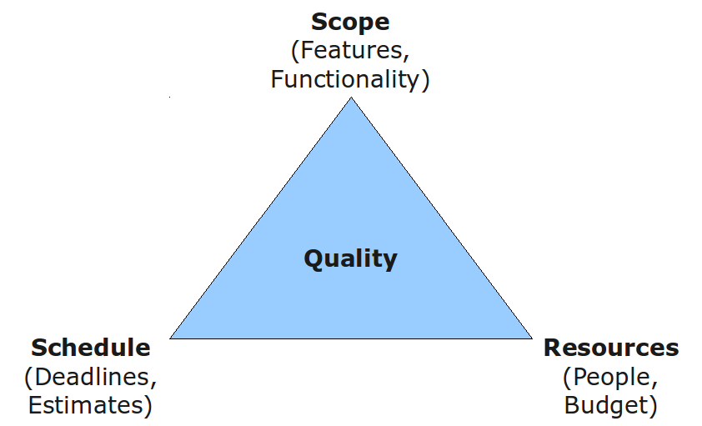
Project Management Triangle
Notes:
Explain the consequence of increase in all directions
And how the quality can be controled
If time exceeds intended limit, reduce scope so that the cost is controlled.

Slide 19
What Is a Methodology?
A formalized approach or series of steps
Writing code without a well-thought-out system request may work for small programs, but rarely works for large ones.
Notes:
Discuss methodology for making a peanut butter and jelly sandwich with milk and cookies for lunch
Actors: aPerson, aFridge, aCupboard, aSandwich, aLunch, aLunchBag
Processes: GetJelly, GetMilk, GetPeanutButter, GetBread, GetCookies, Create Sandwich, CreateLunch, GetLunchBag, PutLunchInBag

Slide 20
Well known Methodologies
Waterfall development
Rapid application development
Agile development
Scrum
We will look at these in more detail next semester. Today we will just try to get the big picture.

Slide 21
Categories of Methodologies
Predictive, Structured Development
Waterfall Development
Parallel Development
Rapid Application Development
Phased
Prototyping
Throwaway Prototyping
Adaptive, Agile Development
Extreme Programming (XP)
Scrum

Slide 22
Structured Development
Projects move methodically from one to the next step
A very controlled approach
Generally, a step is finished before the next one begins
Highly recommended for high risk systems, such as systems that have an impact on human safety
Notes:
Popular in 1980s – formal step by step approach to developing a system

Slide 23
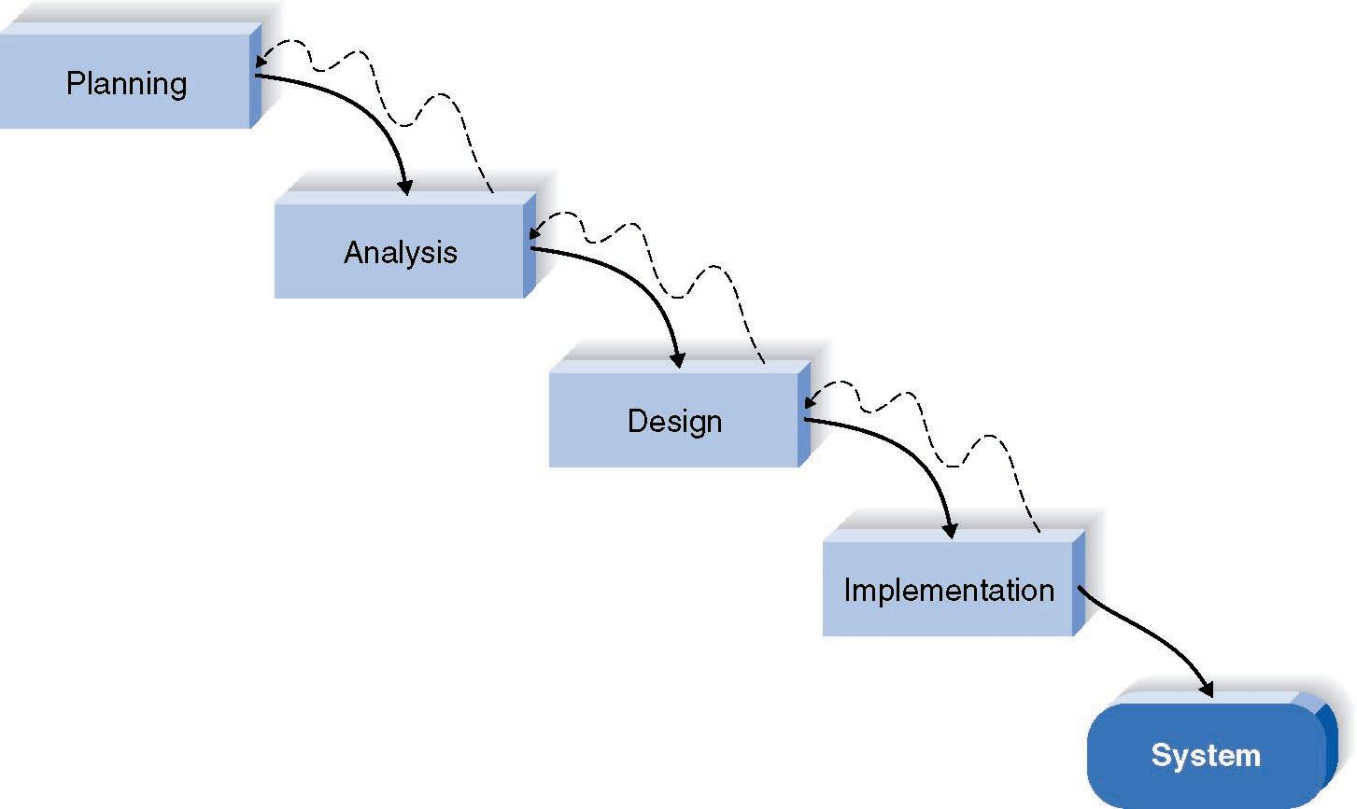
Structured Development: Waterfall
Notes:
Advantages: Identifies system requirements long before programming begins and minimizes changes
Disadvantages: Design must be complete before implementation begins; long time lapses between beginning of planning and a system

Slide 24
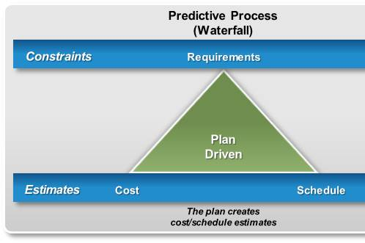
The IRON Triangle
Notes:
This fixed requirement scope in the waterfall methodology is what causes project failure.
Quality is missing on this diagram – since requirements, cost and schedule are fixed, quality is what is variable.

Slide 25
Structured Development: Parallel
Design for the entire system is divided into distinct subprojects
Subprojects, also referred to as Pilot Projects, are delivered one at a time
Once all pilot or subprojects are delivered, the separate pieces are integrated and the system is delivered
Notes:
Often used for software/hardware upgrades.

Slide 26
RAD Categories Rapid application development
Phased development
A series of versions
Prototyping
System prototyping
Throw-away prototyping
Design prototyping

Slide 27
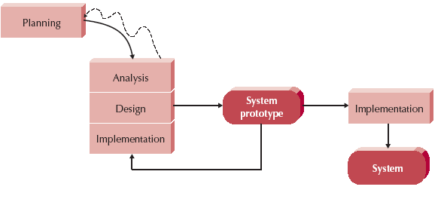
How Prototyping Works
Notes:
Begin with basics of analysis and design
Create a system prototype “Quick and dirty” look at the system
Minimal features, but look and feel is there
Show it to the users and get their feedback
Re-analyze, re-design, re-implement; may add features the second time, may add another screen
Advantage – quick feedback from user
Disadvantage – users constantly not happy – when are you done?; may sacrifice careful analysis: build car and need to remove engine to change oil

Slide 28
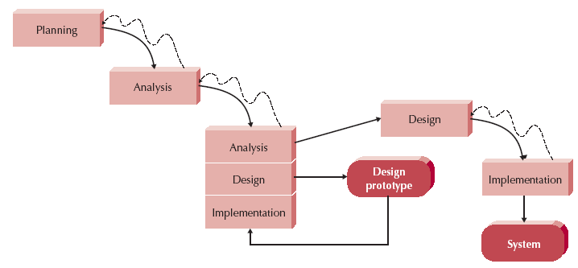
Throwaway Prototyping
Notes:
Use when you don’t really understand what the user wants
Do a pretty thorough analysis, move to design but prototype to make sure you understand
Not whole system, just the part that you are not sure of; not sure if it is feasible or how to design the solution
Users are not sure how to do order entry; build HTML pages to show them the layout, etc.
Sometimes called storyboarding
Advantage – feedback on difficult or misunderstood parts
Disadvantage – extra time required

Slide 29
Agile Development
Gaining strength in the industry
Programming-centric
Eliminates documentation and modeling overhead
Emphasizes simple, rapid iterations of application
4 core values: Communication, simplicity, feedback, courage
Notes:
Rapid feedback between developers and users
Follow KISS principle
Incremental changes and grow the system – accept and embrace change
Quality first mentality
Test Driven development is key as is many releases to customer

Slide 30
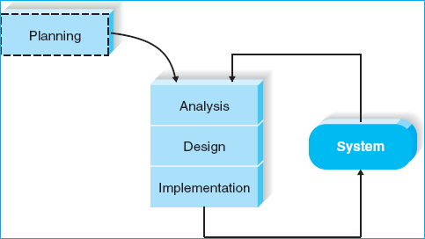
Agile Development

Slide 31
Agile Emphasizes...
Individuals and interactions over processes and tools
Working software over comprehensive documentation
Customer collaboration over contract negotiation
Responding to change over following a plan

Slide 32
Agile Development
Many different processes are Agile
Extreme Programming
Agile Unified Process
Scrum/Sprint
Open Unified Process
Kanban
Lean
Notes:
Agile development is an umbrella term for many different things
They all fundamentally incorporate iteration and the continuous feedback that it provides to successively refine and deliver a software system. They all involve continuous planning, continuous testing, continuous integration, and other forms of continuous evolution of both the project and the software.
Your book only talks about Extreme Programming
You can google the other types…

Slide 33
Agile methodology usage
Notes:
Ref: Version One, 2013 State of Agile Survey

Slide 34
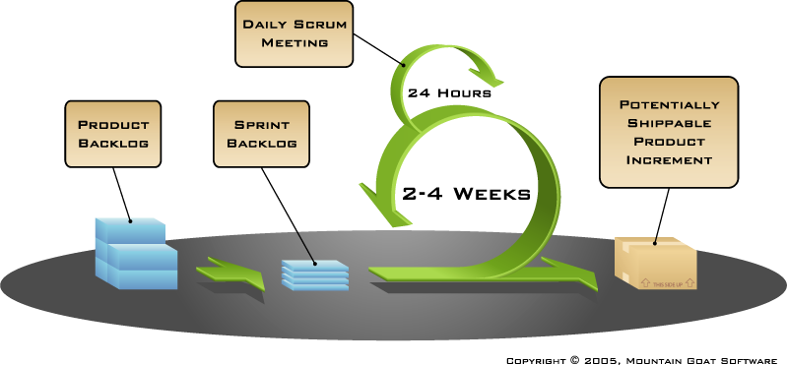
The Sprint/Scrum Process

Slide 35
Scrums
Scrum is a 15 minute daily meeting where each person on the team says:
What they’ve done,
What they’re going to do,
Any problems/coordination/help they need
Notes:
Give example of daily meetings with dev team and what is discussed

Slide 36
Sprint
Scrum projects work as a series of sprints
A sprint lasts no more than 30 days
Every sprint has a specific goal
An executable demonstrating the goal will be completed by the team during the sprint
The sprint team has final say in estimating and determining what they can accomplish during the sprint

Slide 37
Agile Fixes the Iron Triangle
Notes:
Agile fixes the date and resources and varies the requirements

Slide 38
Selecting the Appropriate Methodology
Clarity of User Requirements
Familiarity with Technology
System Complexity
System Reliability
Short Time Schedules
Schedule Visibility

Slide 39
Selecting the Right Methodology
Usefulness for | Waterfall | Parallel | Phased | Prototyping | Throwaway Prototyping | Agile
Unclear user requirements | Poor | Poor | Good | Excellent | Excellent | Excellent
Unfamiliar technology | Poor | Poor | Good | Poor | Excellent | Excellent
Complex systems | Good | Good | Good | Poor | Excellent | Poor
Reliable systems | Good | Good | Good | Poor | Excellent | Good
Short time schedule | Poor | Good | Excellent | Excellent | Good | Excellent
Schedule visibility | Poor | Poor | Excellent | Excellent | Good | Good

